Slide 1
Successful Men’s ministry events

Slide 2
Your Goal is providing a greenhouse for friendships and connection to happen.

Slide 3
Ice Breakers
What toys did you play with as a kid?
When was a time you were scared?
Do you have a time an angel protected you?
How did your parents wake you up?
What is a memorable breakfast?
What is the best gift you gave someone?

Slide 4
Questions going deeper
Who is someone not family who has loved you.
When is a time you were really sick?
Who stuck up for you in your life.
One of the most joyful days of your life.
Tell about a time you were really lonely.
Tell of something that worked out at the right time.

Slide 5
Affirmation circle

Slide 6
Things to watch for
People who take over.
Confidentiality
Variety
Train leaders
Mentor the next generation.
Projects that serve

Slide 7
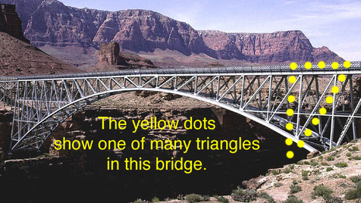

Slide 8
Prayer Breakfasts
Hockey Night
Pickleball night
Barbecue
Read a book and discuss
Men’s Sabbath School

Slide 9
Monthly meeting
Father daughter brunch
Father Son dinner
Valentines dinner for couples
Valentines Singles dinner
Support lonely at Christmas

Slide 10
Sometimes a bible study
Sometimes a short devotional and activity
Sometimes prayer with an activity
Remember sometimes less is more.
Invite Community friends

Slide 11
Men’s day
Men’s retreat
Take a summer break if needed
Spiritual topics series
International food potluck

Slide 12
Year 3 mission trip?
Men’s ministry Evangelism
Men’s ministry service day
Single mothers oil change

Slide 13
Write thank you notes
Personal contact with men in the group
Have spiritual goals
Be sensitive to the spirit’s leading
Keep your pastor updated

Slide 14
Reach for men’s hearts
Be appropriately vulnerable
You go first
Have a prayer list
Prayer walk with other men’s ministry leaders

